Slide 1


ME5535 - Introduction to Electric Drive Engineering Solid State, Semi-Solid State & Sodium Batteries Fall 2024
Project Group #3
Suryakiran M. George, Michael Wnuk, Sydney Kilgore
Notes:
Solid-state, semi-solid state, and sodium batteries are all types of advanced energy storage technologies that represent alternatives to conventional lithium-ion batteries. They each have their own unique structures, advantages, and challenges. Let’s dive in –
Solid-State Batteries offer the highest potential in terms of energy density and safety but face significant manufacturing challenges.
Semi-Solid State Batteries provide a middle ground with easier manufacturing and improved safety over traditional lithium-ion batteries but may not match the energy density of solid-state designs.
Sodium-Ion Batteries are an exciting alternative to lithium-ion batteries due to their lower cost and abundant raw materials, but they currently offer lower energy density, making them more suitable for stationary storage applications rather than portable electronics or electric vehicles.

Slide 2
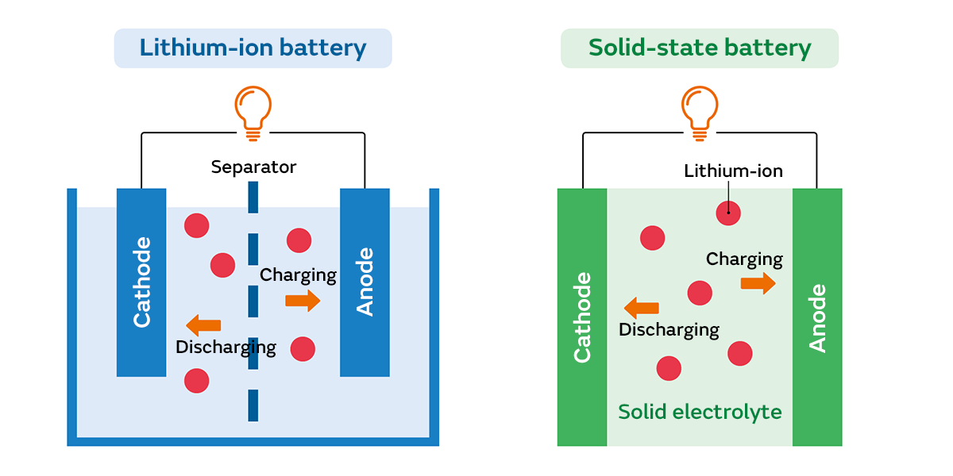
Solid State Batteries (Surya)
Notes:
Li-ion Batteries are currently the most common and cost-effective solution for portable energy storage but are limited by safety concerns, energy density, and lifespan.
Solid-State Batteries hold the potential to revolutionize energy storage with higher energy density, better safety, and longer lifespans but are not yet commercially viable on a large scale due to high costs and manufacturing challenges. However, ongoing research suggests that they could be a game-changer in the near future.

Slide 3
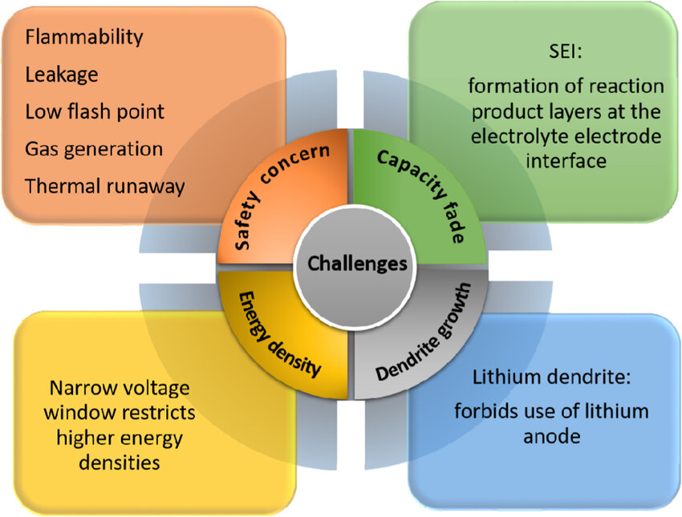
Liquid Electrolyte Li-Ion Battery
High energy density
Long cycle life
Proven Technology
Organic liquid Electrolyte 🡪 low thermal stability & low flame point ❌ Risk of thermal runaway
Leakage and Dendrite Growth
Notes:
Electrolyte: LIB → Liquid electrolyte (typically a lithium salt dissolved in a solvent) that allows ions to move between the anode and cathode.
SSB → Uses a solid electrolyte, which can be made of ceramic, glass, or a solid polymer. This replaces the liquid electrolyte found in Li-ion batteries.
Components: LIB → Consist of a liquid electrolyte, graphite anode, and a cathode typically made of lithium metal oxide.
SSB → Use solid electrolytes and can have solid anodes (e.g., lithium metal) and cathodes.
Energy Density: LIB → Energy density typically ranges from 100-250 Wh/kg, depending on the specific chemistry used. liquid electrolyte can limit energy density as it requires a balance of safety and capacity
SSB → Potential for much higher energy densities, ranging from 500-1000 Wh/kg. The solid electrolyte allows for the use of lithium metal anodes, which can store more energy than graphite.
Safety:LIB → Liquid electrolytes can be flammable and prone to leakage or thermal runaway (fire) if damaged, overcharged, or short-circuited. More sensitive to physical damage and higher temperatures.
SSB →More stable and safer than Li-ion batteries due to the solid electrolyte, which is non-flammable. Less prone to thermal runaway, reducing the risk of fires and leakage.
Charging Speed: LIB → Charging speed can be fast but is limited by factors such as internal resistance and the formation of lithium dendrites (crystal-like structures) that can cause short circuits if they grow too large.
SSB → Potential for faster charging times, as the solid electrolyte can be more efficient in ion movement, and there’s less risk of dendrite formation compared to liquid electrolytes.
Durability and Lifespan: LIB → Typically last between 500-1,500 charge cycles before capacity begins to degrade(due to wear & tear of liquid electrolyte & dendrite growth).
SSB → Potential for longer lifespans (2,000+ charge cycles) due to the more stable nature of the solid electrolyte and reduced dendrite growth. Greater resistance to degradation because the solid-state structure is less affected by wear.
Temperature Tolerance: LIB → Can operate in a temperature range of around -20°C to 60°C, but their performance drops significantly in extreme cold or heat.
SSB → Have better tolerance to a wider range of temperatures, making them ideal for use in extreme conditions (hot or cold) without significant performance loss.
Cost: LIB → Currently much cheaper and more widely produced, with costs decreasing over time due to economies of scale.
SSB → Still in the developmental and early commercialization stages, meaning they are much more expensive to produce. However, as production methods improve, costs are expected to decrease.
Commercialization and Availability: LIB → Established technology, widely used in consumer electronics, electric vehicles (EVs), and energy storage systems. Production is mature and scalable.
SSB → Not yet widely available. While prototypes have shown great promise, they are still being developed and refined by companies and researchers. It will likely take several more years for them to become commercially viable on a large scale.

Slide 4
Need for Better Li-ion Batteries : Solid Electrolytes
NASICON type
High Ionic Conductivity
Good Chemical & Electrochemical Stability
Expensive
LISICON type
Low Ionic Conductivity
Good Chemical & Electrochemical Stability
LIPON type
Low Ionic Conductivity at room temp
Garnet type
High Ionic Conductivity
Stable with Lithium, Not stable in ambient atmosphere
Li3N type
Decomposition voltage too low for high energy density
Perovskite type
Ionic Conductivity not high enough yet
Promising but preparation condition very harsh
Sulfide type
Highest Ionic Conductivities
Not stable in ambient atmosphere coz of reaction with moisture
Notes:
Here is an overview of major types of solid electrolytes, including NASICON, LISICON, Garnet, LIPON, Li₃N, Perovskite, and Sulfide types.
Each type has its own strengths and weaknesses depending on the specific requirements of the battery or electrochemical device.

Slide 5
In Pursuit of All Solid State Li-Ion Battery
High safety
High energy density
Inorganic solid electrolytes - high thermal stability
No leak & Simpler packaging - increased energy density
Problems with electrochemical interfaces
Engineering challenges
No solid-state cells have achieved parity with traditional systems yet
Manufacturability, cost, and long-term stability not addressed yet
Focus: Critical areas for development, especially related to materials like LLZO(Lithium Lanthanum Zirconium Oxide) and LPS(Lithium Phosphorus Sulfide), and the challenges involved in full-cell integration, processing, and optimization for reliable performance.
Notes:
The two major candidates for solid-state electrolytes (SSEs) in lithium-ion batteries are:
Garnet-Type Oxides (e.g., LLZO):
Example: Lithium Lanthanum Zirconium Oxide (LLZO) is one of the most prominent garnet-type SSEs.
Advantages: High ionic conductivity at room temp, good mechanical strength, excellent stability with lithium metal and good thermal stability..
Challenges: Difficult to process (requires high-temperature sintering), and issues with interfaces(poor ionic conductivity) between the electrolyte and electrodes.
Sulfide-based Inorganic Solid Electrolytes (e.g., LPS):
Example: Lithium Phosphorus Sulfide (LPS) is a leading sulfide-based SSE.
Advantages: Very high ionic conductivity, often higher than garnet-type electrolyte, Compatible with lithium metal anodes(high energy densities) and easier to synthesize.
Challenges: High sensitivity to moisture and oxygen, making it challenging to handle and requiring careful sealing and protection.Suffers from interface resistance with electrodes, requiring careful engineering.
Both candidates are considered promising for next-generation solid-state batteries due to their high ionic conductivities and potential for improved safety compared to liquid electrolytes. However, they each have unique challenges related to processing, stability, and interface management.

Slide 6
Fundamental Materials Research need Holistic View
Full Cell Architecture as a guide 🡪 Towards material innovation 🡪 Robust Product
Processing techniques (Is it pragmatic?)
SSE microstructure geometry ( Does it change with cycling(Impedance gain), temp?)
Ionic conductivity, electronic conductivity (High? Low?)
Low Interfacial Resistance (P,T for sulfides?, Surface modification for oxides? Interface agents?)
Chemical stability with materials in contact
Stable voltage window
SEI stability (Ionic conducive?, Is it self limiting?, New failure modes?)
C-rate, cycling behavior, energy density
Temperature range
Self discharge rate
Integration methods
Alternative failure modes (Roadblock to commercialization?)
Notes:
Holistic Approach Required: Merely improving ionic conductivity is insufficient for advancing solid-state battery technology. A comprehensive approach that includes material processing and interface optimization is critical. This involves addressing various factors that influence performance and stability.
Processing Techniques:
Oxide-Based SSEs - Hard to process due to brittleness. Solid-state sintering often required at high temperatures (up to 1000°C), which can lead to poor cost efficiency. Research is exploring low-temperature processing and additives to lower the sintering temperature.
Sulfide-Based SSEs - Easier to process at lower temperatures, with methods like cold pressing or solution-based deposition. They are more easily shaped into films or dense monoliths.But, Moisture sensitivity during processing and storage requires strict environment control.
Microstructure Geometry and Cycling Effects:
Oxide-Based SSEs - The grain boundaries in oxide SSEs are prone to poor ionic conductivity and may grow larger over cycling, leading to impedance increase. With cycling, the impedance can increase due to microstructural degradation, leading to interfacial resistance issues.
Sulfide-Based SSEs - More homogenous, but susceptible to microstructural changes during cycling, especially due to lithium dendrite formation. Impedance increase due to both dendrite growth and interfacial reactions with lithium metal.
Low Interfacial Resistance:
Oxide-Based SSEs - Interfacial resistance between oxides and lithium metal is a significant issue, with research focusing on surface modifications (e.g., using interface agents or coatings) to improve contact. Doping or using conductive additives can help, but their effectiveness is still under research.
Sulfide-Based SSEs - Better interfacial contact with lithium, with lower interfacial resistance. But Surface modification is necessary to prevent moisture-induced degradation.
Conductivity: Ionic and electronic conductivities are critical parameters. High ionic conductivity is essential for efficient ion transport, while low electronic conductivity can help minimize parasitic reactions within the battery.
Chemical Stability: The stability of materials in contact with each other is paramount to prevent degradation over time.
Performance Metrics: Key performance indicators such as C-rate, cycling behavior, energy density, temperature range, and self-discharge rates are critical in evaluating the viability of ASSBs in real-world applications.
Integration Methods:
Oxide-Based SSEs - Integration with electrodes often involves complex surface modification or interface engineering.
Sulfide-Based SSEs - Easier integration with electrodes due to better interfacial contact, but surface passivation may be needed to avoid moisture degradation.
Alternative Failure Modes and Roadblocks to Commercialization:
Oxide-Based SSEs - Brittleness and interface instability are key barriers. Interfacial resistance and cost-effective processing remain hurdles for large-scale adoption.
Sulfide-Based SSEs - Moisture sensitivity, chemical instability with lithium, and dendrite formation are major roadblocks. Manufacturing challenges for stable sulfide-based SSEs with high energy density also persist.

Slide 7
Key Focus Areas:
Solid Electrolyte Mechanical Considerations: Success of SSEs in preventing Li penetration and dendrite growth hinges on controlling material properties, interface quality, and defect-free layers.
Materials Fabrication: Achieving defect-free, thin SSEs for solid-state batteries remains a major hurdle for scalable production.
Processing Techniques:
Oxide based SSE (sintering process):Techniques such as tape casting, pulsed laser deposition (PLD), and atomic layer deposition (ALD) are being explored for achieving thin oxide SSE films, though scalability remains a concern.
Sulfide-based SSEs(need strict moisture control): consolidated under pressure at low temperatures. Challenges in thin-film processing include achieving high-density films and controlling crystal structure.
Notes:
SSE thicknesses in the <100 μm range are necessary to minimize bulk resistance and enable cell energy densities competitive with conventional Li-ion technology. Typical separators used with liquid electrolytes are ≤25 μm.
By optimizing material composition, and employing advanced deposition techniques like ALD or roll-to-roll processing, it is possible to produce defect-free, thin solid-state electrolytes.
Conclusion:
The successful manufacturing of All-Solid-State Batteries relies on addressing the mechanical considerations of solid electrolytes, achieving defect-free fabrication processes, and optimizing processing techniques. Innovations in cold sintering, high-energy ball milling, and thin-film deposition methods are paving the way for enhanced performance in ASSBs. However, overcoming challenges related to scalability, moisture sensitivity, and interface stability will be essential for realizing the full potential of ASSB technology in commercial applications.

Slide 8
Key Focus Areas:
Solid Electrolyte Interfaces (Failure Modes):
Stability Requirements: SSEs cannot remain stable across the wide potential range between negative and positive electrodes
Failure Modes: catastrophic failures like electrical shorts to performance issues such as reduced capacity. Key issues include interfacial delamination, caused by volume changes in electrodes during charge cycles, and non-uniform current density distribution that can lead to poor performance or short-circuiting.
Delamination and Mechanical Issues: Volume changes in electrodes, particularly during intercalation or lithiation, can cause mechanical stress, leading to delamination or fracture
Current Density Distribution: The formation of low-density lithium (Li) metal during cycling can create non-uniform current densities, leading to electrical hot spots, shorting, and reduced Coulombic efficiency, which results in capacity fade.
SSE-Cathode Compatibility: SSEs often react with cathode materials at elevated temperatures, affecting performance. Suggested usage of protective coatings
Notes:
Conclusion
The stability and performance of All-Solid-State Batteries are heavily influenced by the interactions at solid electrolyte interfaces. Addressing challenges related to stability requirements, failure modes, mechanical integrity, current density distribution, and SSE-cathode compatibility is vital for advancing ASSB technology.
Innovations in protective coatings and improved understanding of interface dynamics will be key to enhancing the reliability and efficiency of ASSBs in practical applications.

Slide 9
Key Focus Areas:
The opportunity cost of a Li metal anode: While Li metal anodes offer high energy density potential, their practical application involves significant challenges related to morphology changes, kinetic limitations, and failure mechanisms.
Integration of SSEs into full cell structures: Interfacial contact between the electrodes and SSE is critical for performance, and methods like pressure, temperature, and surface modification can help improve contact. Discusses Hybrid systems, anode free designs etc. Potential for higher energy densities in solid-state batteries is acknowledged, though true energy density calculations are often not clearly reported in studies.
Notes:
Overall, solid-state battery development represents a complex balancing act between improving interface stability, managing lithium metal anode challenges, and optimizing overall cell architecture for long-term performance.
While there is significant potential for higher energy densities in solid-state batteries, precise calculations are often lacking in studies.
As research progresses, these challenges will need to be carefully navigated to unlock the full potential of solid-state batteries in commercial applications.

Slide 10
Conclusion
SSEs may offer safety benefits, but they also introduce new challenges, such as the toxicity of certain materials (e.g., sulfides releasing H2S), and unforeseen failure modes that may not be present in liquid systems.
Pragmatic realization is potentially years to decades away
To ensure safety, rigorous testing, smart battery management, and engineering controls like vents or shutdown separators are essential.
Improving conductivity alone is insufficient; a holistic approach focusing on material processing and interface optimization is essential for advancing solid-state battery technology.
Specific Research Vectors for Future :
Scalable manufacturing of low defect density thin ionic conducting solids
Characterization methods to determine defect densities at relevant scales
Increasing ionic conductivity of solid state electrolytes further
Protective active cathode particle coatings
Developing high ionic conductivity materials that are deformable or have low melting temperature
Increasing active cathode particle fraction in solid state electrodes.
Notes:
While solid-state battery technology holds immense promise, realizing its potential requires overcoming technical, material, and engineering challenges. The pursuit of higher ionic conductivity, safer materials, and improved interfacial compatibility will define the future of this technology. A holistic approach, incorporating advances in material science, processing techniques, and battery management systems, is essential to making solid-state batteries a mainstream energy storage solution.
By addressing these specific research vectors, the scientific community can address the key challenges and make solid-state batteries safer, more efficient, and commercially viable in the coming decades.

Slide 11
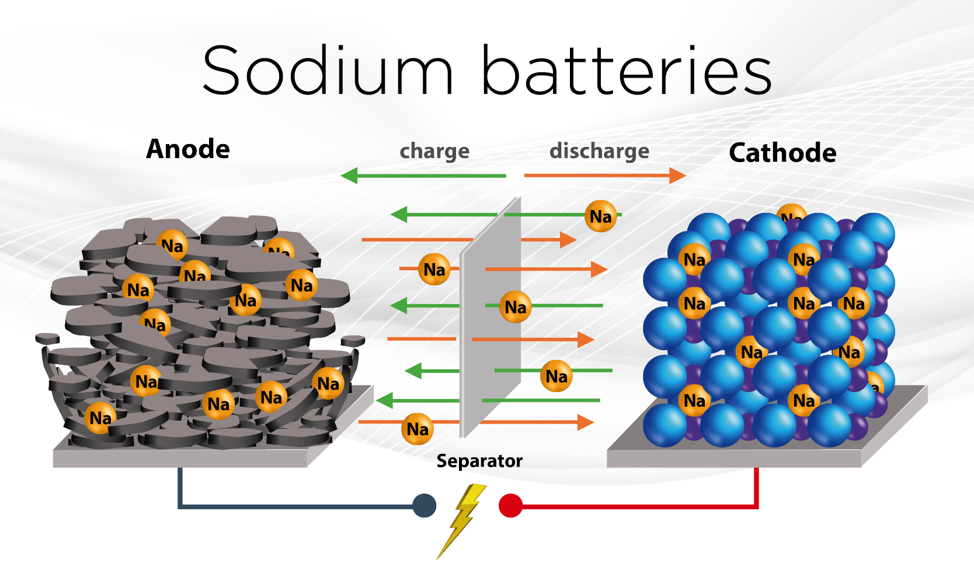
Sodium Batteries (Michael)

Slide 12
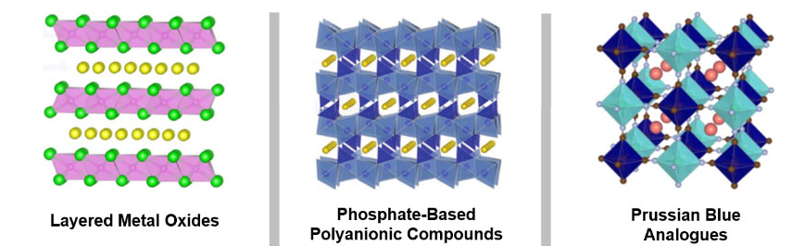
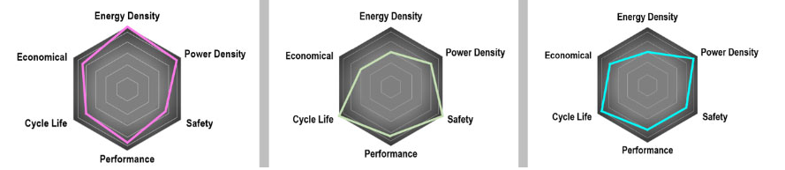
Top 3 Na-ion Battery Types
Notes:
Sodium-ion development started back in the 1970s, but development stalled upon the discovery of Lithium-ion batteries. Sodium batteries are on the rise again and it's good to know the what they are. Sodium-ion batteries, like Lithium-ion, does not refer to a single chemistry but to the generalise use of sodium as the cation. Sodium batteries can be liquid, solid, or molten. Molten is very uncommon due to its cost, complexity, and safety concerns.The top three types are distinguished by their cathode material. Layered metal oxides use Hard Carbon, Phosphate-based use prussian blue or white cathode. Prussian Blue analogous use special blend of sodium.
Layered Metal Oxides use a Hard Carbon Anode. It has the highest energy density and capacity of the sodium batteries Similar structure as Lithium-ion metal layered oxide batteries. The electrolyte is usually a liquid that contains sodium salts, such as sodium hexaflourophosphate.
Phosphate-Based Polyanionic compound has lowest energy capacity of all three. They have great cycle life and have higher safety due to the covalent bonding of oxygen. It uses a solid electrolyte in its makeup.
Prussian Blue analogues have all around good properties, but noticeably lower energy capacity than LMOs. They use an aqueous electrolyte solution
In the end, NA-ion batteries operate the same as Li-ion batteries, but replace the Li ion with the sodium ion as the charge carriers.

Slide 13
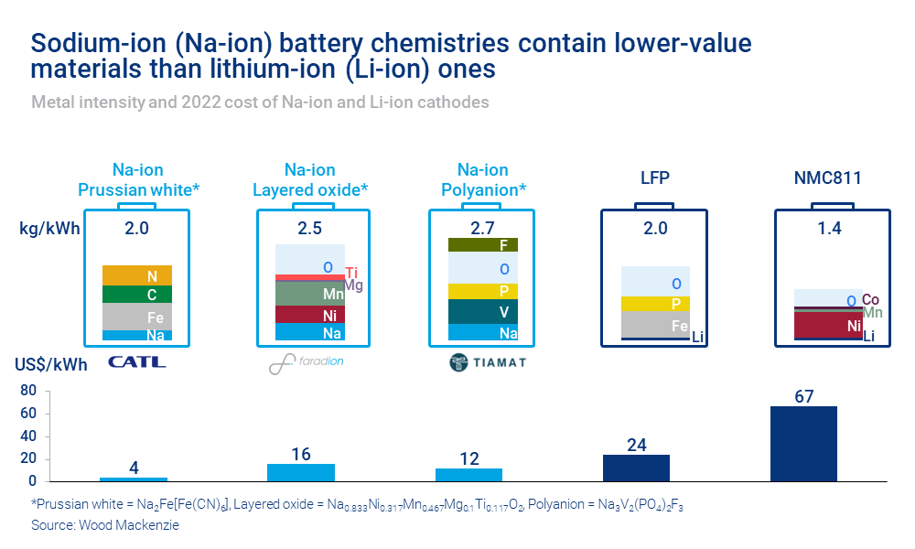
Notes:
As the graphic shows, the sodium-ion batteries use more commonly found materials, Sodium, Carbon, and Iron.. They are widely abundant in comparison to Lithium on a global scale as well as a regional area. This helps drive the cost down on raw materials which can aid in the scaling up of production globally. By not being glued to the rare deposits of Li, companies can look into sodium batteries in cost effective uses, which currently is midrange EVs’ .
https://www.woodmac.com/news/opinion/sodium-ion-batteries-disrupt/

Slide 14
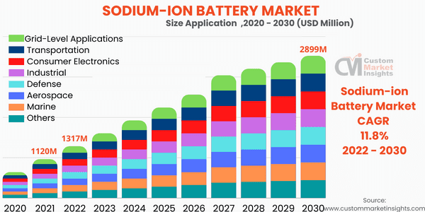
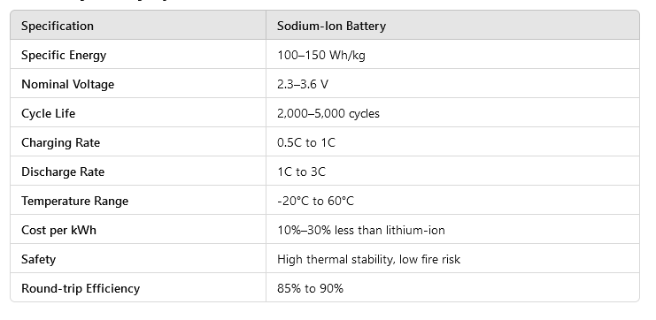
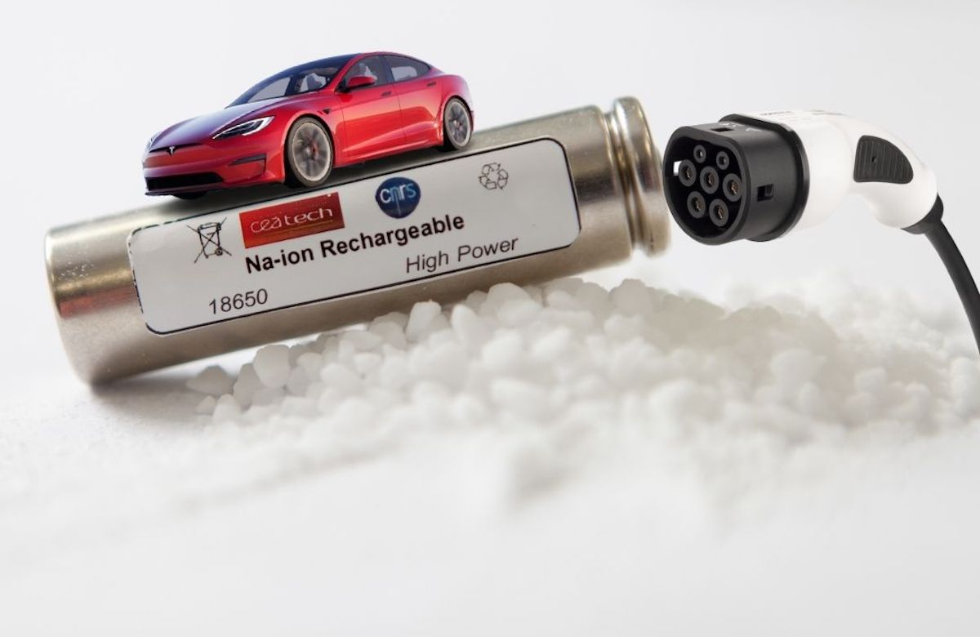
Na-ion on the Rise
Notes:
The specifications on the NA-ion battery ranges due to its type. One major advantage is their ability to hold a charge at low temperatures. At -20 C, they still have a 90% charge capacity. As their cost of materials are low, have high safety marks, and life cycles are long, their applications are growing annually. In the last 4 years, they about doubled and should reach a 2.9 billion market by 2030. Outside of EV’s they have a growing application as mass energy storage for renewable sources as well as charging stations for EV’s. This side effect could help buffer the strained Electrical Grid.

Slide 15
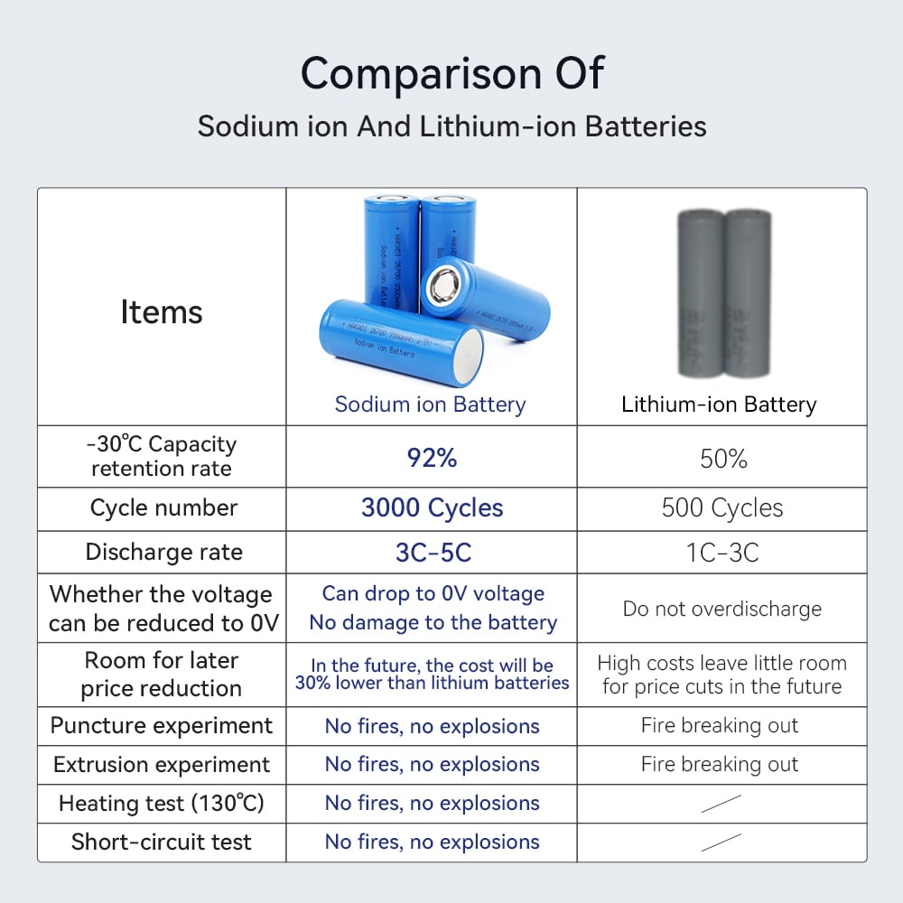
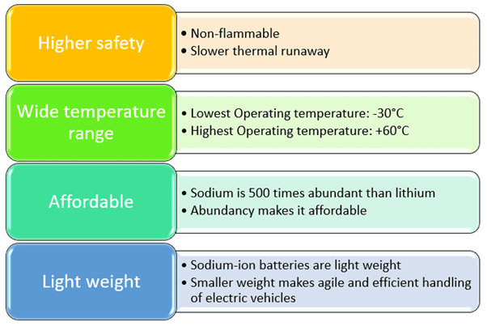
Pros over Na-ion
Notes:
The Higher safety for NA Batteries come from their ability to handle temperature without risk of thermal runaway. This is because sodium reacts less violently than Lithium at high temperatures. They have more stable chemistry and thus have lower reactions to overcharging or physical damage. Sodium, unlike Lithium, tends to stay in its ionic form which reduces the risk of deposits on the anode that could short out the circuits. Lastly, NA batteries use electrolytes that are more chemically stable and les volatile.
Their wider operating temperature range, especially at lower temps, is due highly to the low reactivity of sodium and the more stable electrolyte used. The anode and cathode materials have better stability under extreme temperatures than those in their Li-ion counterparts. The larder size of Na ions help with their thermal stability, but at the cost of lower energy density.
Sodium being 500x more abundant give to its affordability. Also sodium costs about $0.1-0.3/kg, while Li is $12-20/kg. The metals used, Iron $0.50-$1/kg and Mn $2-3/kg, in sodium batteries cost less than the metals in Li-ion, Ni $20-25/kg and Co $30-60/kg. In general NA-ion are 30-50% cheaper than Li-ion.
Though in general, NA-ion are light weight compared to Lead acid batteries, they are not as light as Li-ion batteries.

Slide 16
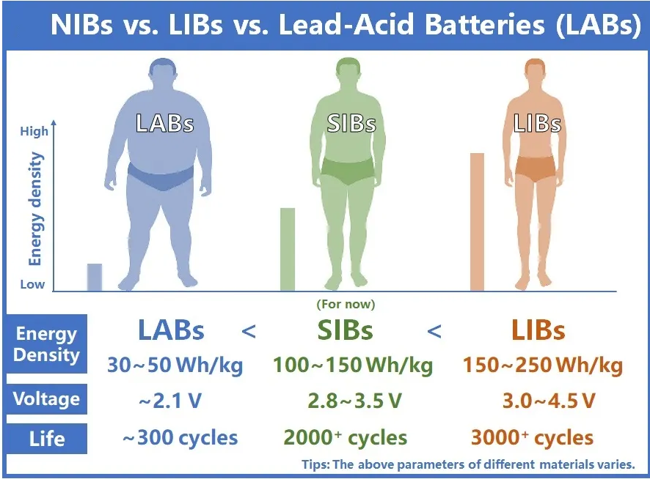
Challenges of Na-ion
Lower Energy Density
Heavier and Bulkier
Development stage
Notes:
They have lower energy density than Li-ions, primary due to the size of Na ions. To have the same power output as Li-ion a larger battery is needed. This larger size also adds more weight to the battery. Lower energy density and bulkier batteries go hand and in hand with each other. Lastly, sodium batteries are still in the development stage. Though their potential could be deserved, it currently comes at price higher than Li-ion.

Slide 17
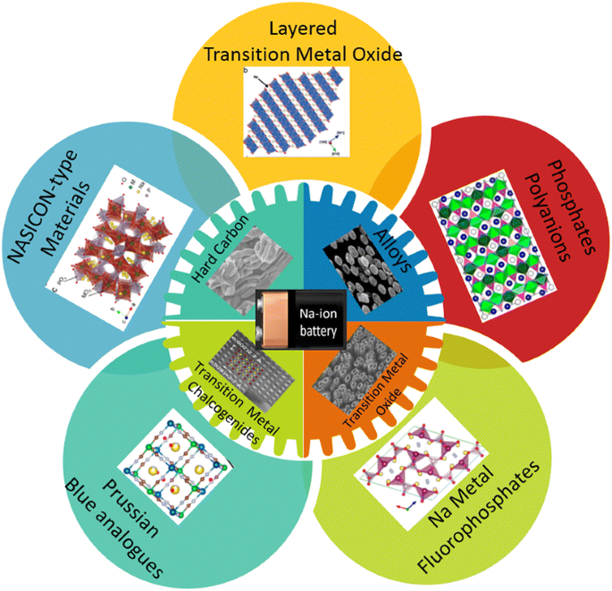
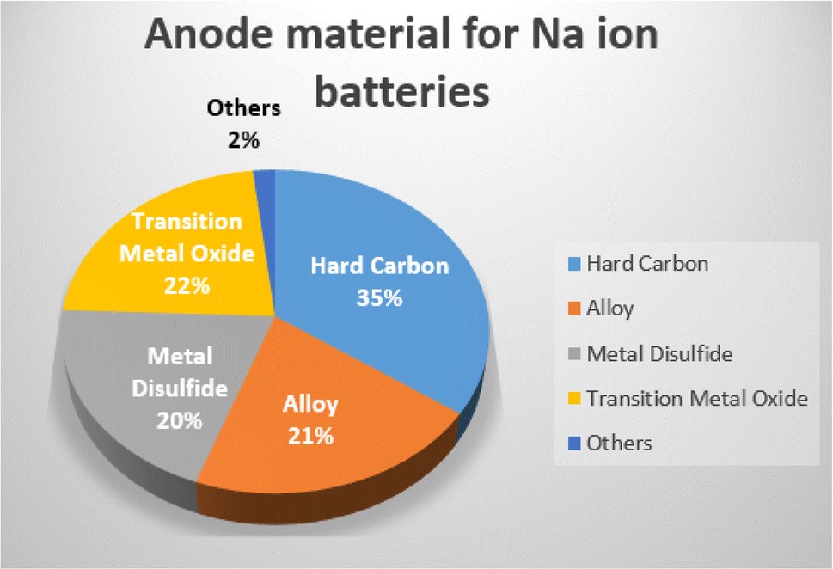
Key Components - Anode
Notes:
The Anode material is pivotal for storing sodium ions. There are 4 main materials used for the anode.
Hard carbon, the most common at 35%, is used for its ability to efficiently store Na-ions and its relative low-cost.
Graphite, though less effective used here than Li-ion, it is still a cheap material. The poorer performance goes back to the larger size of sodium ions which make them harder to fit in the graphites structure.
Tin-based compounds are newer and still being researched. They are considered for their higher capacity, but have issues with expansion during cycling. This expansion can affect the lifespan
Alloys, sodium-tin or sodium-antimony, are also newer options that are being explored, but have an issue with stability.

Slide 18
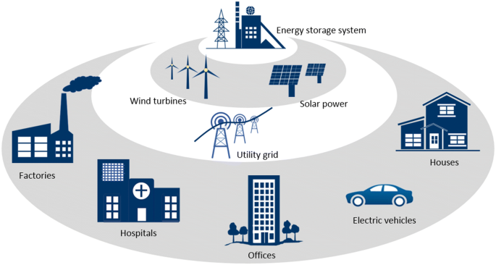
Applications of Na-ion Batteries
Grid Energy Storage
Electric Vehicles
Renewable Energy Storage
Industrial/Heavy-Duty Applications
Military and Aerospace
Notes:
Sodium-ion batteries have become a promising emerging alternative to Li-ion batteries. Between their pros and cons they have some great potential in some key applications.
Grid Energy Storage- With their low cost and abundant materials, they are well suited for a large-scale energy storage system. This can provide the ability of power production to fluctuate less.
With lower energy densities, Na-ion batteries have a better application in mid range EV’s, smaller vehicles, or a more budget-friendly EV model. The urban market where range is less of an issue and reduced cost is more important is the main area that Na-ion batteries are being considered.
Using the batteries to create a battery bank is perfect for energy produced from renewable sources. They can provide backup energy to the grid as well as load-balancing capabilities. Sources such as solar panels or wind turbines don’t provide a steady supply of energy and these batteries can help fill this buffer role.
Industrial applications are intended for use in heavy machinery, ie electric forklifts or electric trucks. Their low cost and abundant materials are what industrial leaders are looking for when trying to increase productivity while adhering to the emission standards.
The high safety of Na-ion batteries is what draws the attention of the military. Their potential use in systems or machinery that require low weight, but high safety makes them perfect for use here. Also for an energy storage bank for field operations or remorse military bases they are an cost effective source. With the military tactics focusing on mobility, the potential of creating a vehicle as an energy storage bank could be a move in the right direction with their tactics.

Slide 19
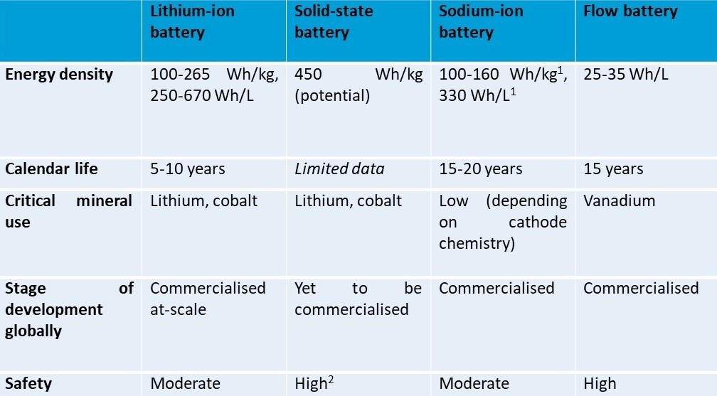
Notes:
Lithium-ion batteries are the dominant force out there in energy storage currently. They have high energy density, long cycle life, an fast charging. However, there are growing options that may rival Li-ion in certain applications. Solid-state batteries have higher energy density and improved safety but have problems with scalability and higher costs. Sodium-ion batteries use abundant cheaper materials, ie sodium and carbon, are more sustainable which makes them a prime candidate for energy storage and backup power. Flow batteries have longer cycle life and good scalabilit, but are bulky which makes them better suited for non-mobile energy storage. Expanding upon battery types for specific applications helps expand the future of renewable energy, ,are more sustainable energy market, and potential for new industries to arise.

Slide 20
Semi-Solid State Batteries (Sydney)

Slide 21
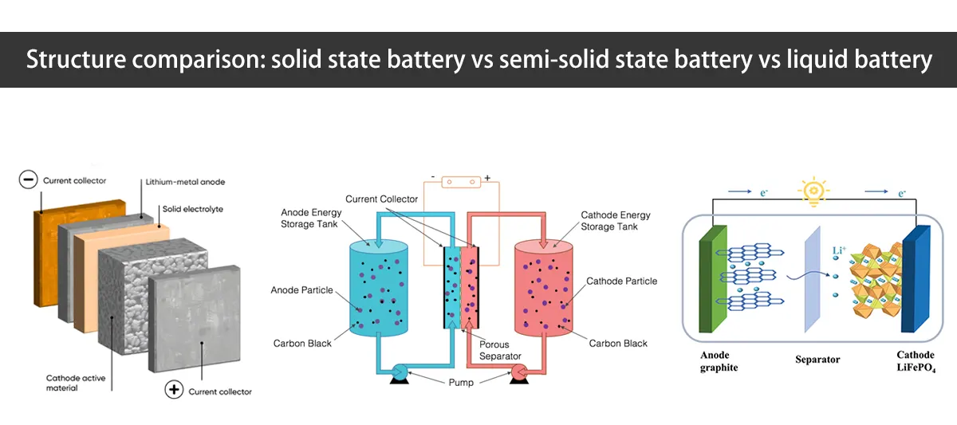
Semi-Solid State Batteries
A hybrid between solid and liquid batteries
Uses solid conductive material and liquid electrolytes
Incorporates positives from Liquid batteries and Solid batteries
Main manufactures: WeLion, FAW group, SAIC Group, CATL and BYD
Notes:
Semi-solid state batteries are batteries that are a hybrid between Liquid and Solid State Batteries. They incorporate positives from both solid and liquid batteries to make a safer alternative to liquid batteries and a cheaper alternative to solid state batteries. Semi-solid state batteries are made of a solid conductive material and liquid electrolytes creating a gel substance. The most expensive part of an EV is the battery, so semi-solid batteries can be an option to help decrease cost.

Slide 22
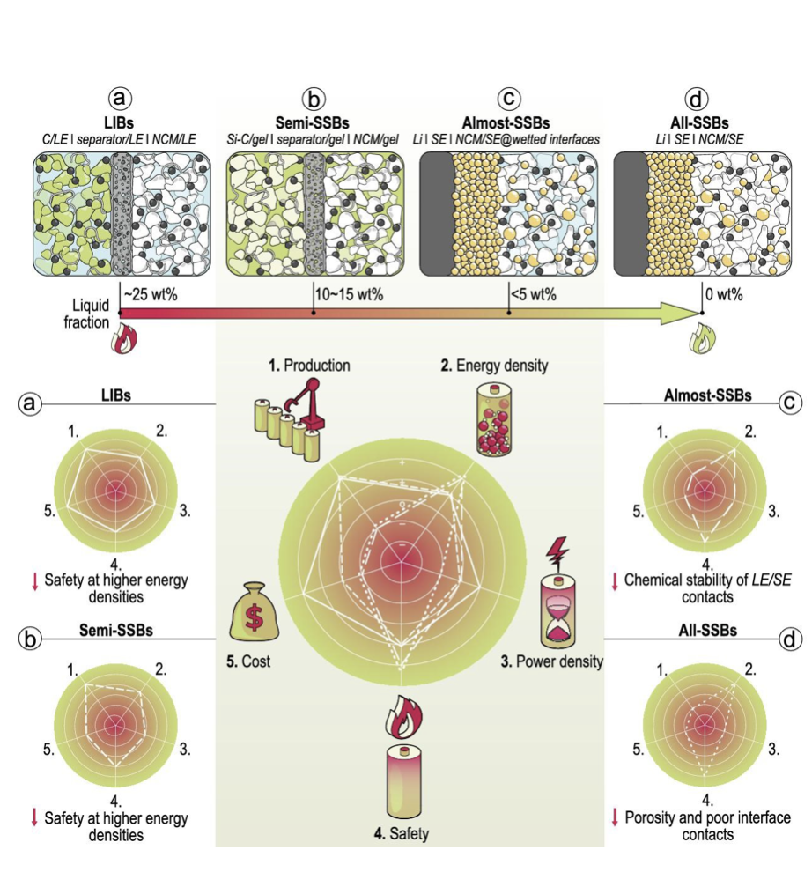
Advantages
Advantages over Liquid Batteries:
More efficient conduction
Solid conductors
Faster charging
Longer lifespan
Safer
Higher energy density
Advantages over Solid Batteries:
Easier to manufacture
Share materials and manufacturing process with liquid batteries
Cheaper
Currently available
Notes:
Semi-solid batteries have more effective conduction than liquid batteries. This is due to the solid conductive material in the gel polymer that helps increase conductivity. The increase in conductive efficiency lowers the charging time required for semi-solid batteries. Semi-solid batteries also have a longer lifespan and are safer than liquid batteries. This is because semi-solid batteries have less liquid in them than liquid batteries, which reduces the chance for leakage, thermal runaway and degradation. This increases lifespan and makes them less likely to catch on fire, increasing safety. They also have higher energy density than Liquid batteries, which is due to the solid conductors. Semi-solid batteries can be made on lithium-ion battery production lines, which makes them easier and cheaper to manufacture than solid state batteries. They are also available currently unlike solid state batteries. This graph shows how each battery compares to the others with respect to production, energy density, power density, safety and cost.

Slide 23
Disadvantages
Disadvantages to Solid batteries
Lower energy density
Shorter Lifespan
More Dangerous
Higher chance of leakage and Thermal Runaway
Disadvantages to Liquid Batteries
More expensive
Notes:
Semi-solid batteries have lower energy density and shorter lifespans than solid state batteries. This is caused by the liquid in the batteries, which leads to degradation and performance losses. The liquid also causes semi-solid batteries to be more dangerous than solid state batteries. They are also more expensive than liquid batteries.

Slide 24
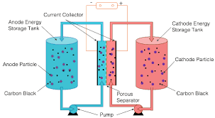
Gel Polymer
Solid conductive material mixed with liquid electrolytes form gel substance
Solid material consists of carbon black, anode and cathode particles and lithium salts
Gel substance increases efficiency of conductivity
Faster charging than liquid batteries
Resists formation of dendrites
Longer lifespan than liquid batteries
Notes:
Semi-solid state batteries are composed of solid ionic conductors and liquid electrolytes. The solid material in this mixture consists of carbon black, anode and cathode particles, and lithium salts. This forms a semi-solid/gel. This gel makes the ionic conductivity more efficient because of the ionic conductors that are in the gel electrolyte. The way that the conductors are suspended in the gel makes it more efficient when conducting. This makes charging quicker than liquid batteries. The gel also resists formation of dendrites during charging which helps increase the life of batteries. This picture shows that the gel polymer consists of the solid material, carbon black, cathode and anode particles and lithium salts and the liquid electrolytes.

Slide 25
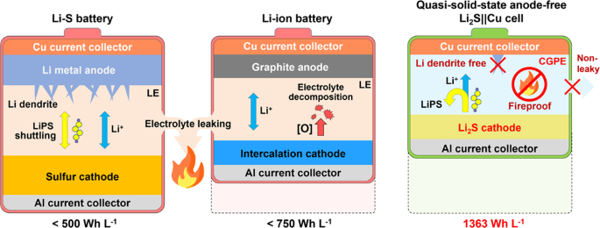
Safety
Safety of semi solid batteries is increased because of the decrease in liquid electrolytes
Liquid electrolytes lead to thermal runaway and leaking
Causes fires
<5% to enhance safety
Notes:
Semi solid batteries are safer than Liquid batteries because they have less liquid in them. The more liquid present, the more likely that leaking and thermal runaway will occur. Leaking and thermal runaway can lead to fires. The amount of liquid in semi-solid batteries is estimated to be between 10-15 wt%. The target to improve safety is less than 5 wt%. Even though many semi-solid batteries do not meet that target, semi-state batteries are still considered to be safer than Liquid batteries. The picture on this slide shows how because semi-solid batteries are less likely to leak, it makes them less prone to fire.

Slide 26
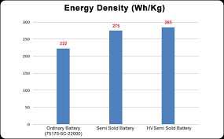
Energy Density
Between 350-400 Wh/kg
Higher energy densities achieved by optimizing pack structures and alternative electrodes with higher specific capacities
Not as high as solid batteries
Higher energy density cause by
Using high voltage cathode and lithium metal anode
Higher ionic conductivity
Notes:
The energy density of semi-solid state batteries is higher than liquid batteries. It is higher because they contain high voltage cathodes and lithium metal anode which causes energy density to increase. The higher ionic conduction also causes the energy density to be higher. Energy densities of semi-solid batteries have been reported to be between 350-400 Wh/kg. The higher energy densities are achieved by optimizing the pack structure and having alternative electrode with higher specific capacities. Although the energy densities of semi-solid state batteries are high, they are not as high as solid state batteries.

Slide 27
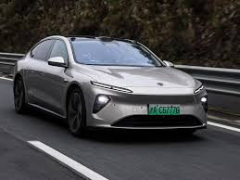
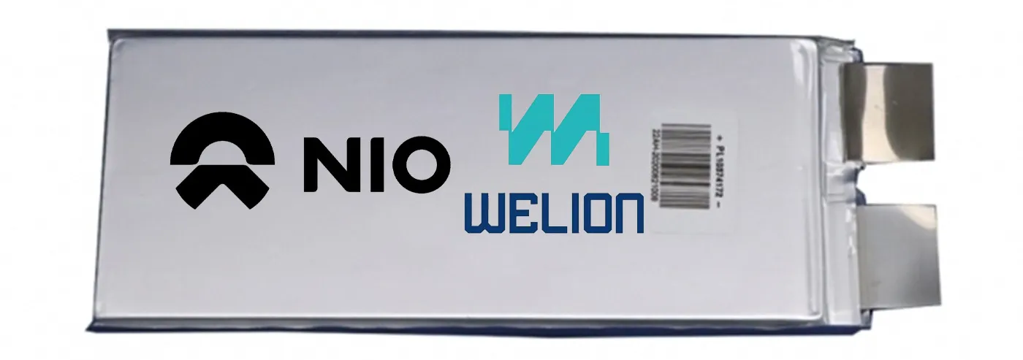
NIO & WeLion semi solid battery
Leaders in Semi-solid batteries
150 kWh
hybrid electrolyte Si-C composite anode and ultra-high Nicathode
Energy density:
360 Wh/kg individually
260 Wh/kg when packaged together
1000 km driving range on single charge
Liquid speculated to be 10-15 wt%
Notes:
Nio and WeLion partnered to start development of semi-solid state batteries. They currently have a 150 kWh battery that powers the ET7. The NIO/WeLion cells have an energy density of 360 Watt-hours/ Kg individually and a density of 260 Wh/kg when packaged. Their battery packs can deliver more than 1000 kilometers of driving range on a single charge. These batteries became available to rent in June 2024. The liquid estimated to be in their batteries is about 10-15 wt%. The pictures in this slide show a WeLion semi-solid battery and the ET7, which features their semi-solid battery.

Slide 28
Sources
https://iopscience.iop.org/article/10.1149/2.1571707jes
https://www.sciencedirect.com/science/article/abs/pii/S0378775318303653?via%3Dihub
https://electrek.co/2024/06/17/nio-semi-solid-state-ev-battery-maker-ramps-output-621-mi-et7/
https://spectrum.ieee.org/semi-solid-state-battery#:~:text=The%20gel's%20structure%20also%20resists,Benz%20to%20commercialize%20advanced%20batteries.
https://academic.oup.com/nsr/article/10/6/nwad098/7115328
https://www.sciencedirect.com/science/article/abs/pii/S0957582024007961
https://www.enpower-greentech.com/news/contrasting-semi-solid-lithium-ion-and-lithium-polymer-batteries#:~:text=Semi%2DSolid%20Li%2Dion%20batteries%20(Li%2Dion%20SSB)%20utilize%20a,less%20liquid%20compared%20to%20traditional%20Li%2Dion%20batteries.&text=However%20with%20the%20introduction%20of%20Semi%2DSolid%20Lithium%2Dion,enhances%20safety%20while%20maintaining%20high%20energy%20density
https://www.detroitnews.com/story/business/autos/ford/2024/05/09/ford-shareholder-meeting-jim-farley-semi-solid-state-batteries/73625910007/#:~:text=Semi%2Dsolid%20state%20batteries%20are%20a%20variation%20of%20that%2C%20typically,the%20semi%2Dsolid%20state%20batteries.
https://www.nature.com/articles/s41467-022-29118-6
https://spectrum.ieee.org/semi-solid-state-battery
https://academic.oup.com/nsr/article/10/6/nwad098/7115328
https://www.youtube.com/watch?v=8V7BJm0dbGA
https://youtu.be/gG2_5GMWf1E?si=3S9jjMr-m1tTJ_Fp
https://youtu.be/RQE56ksVBB4?si=fmWMpIKowMEslcZe
https://youtu.be/bdF1rH9q8qs?si=i7gutO-TFUqsVyP9
https://www.mitsubishicritical.com/resources/blog/the-runaway-review/sodium-ion/
https://www.redwaypower.com/sodium-ion-battery-advantages-and-disadvantages/
https://www.google.com/imgres?q=sodium%20battery%20for%20EV%20specs&imgurl=https%3A%2F%2Fwww.kesheebattery.com%2Fcdn-cgi%2Fimage%2Fw%3D1445%2Cformat%3Dauto%2Ffiles%2Fsocial-media-manager-headphoto%2Ffd610d2596%2F202312%2FSIB_26700_3500mah-7.jpg&imgrefurl=https%3A%2F%2Fwww.kesheebattery.com%2Fproducts%2Fsodium-ion-battery-sib-26700-3-0-v-3500mah-rechargeable-na-ion-cell-for-diy-ebike-battery-pack&docid=cCFtnsdCelahqM&tbnid=hXe3nSB5XTtOqM&vet=12ahUKEwiUtJC0hYOKAxWSmYkEHejHKQMQM3oECBoQAA..i&w=1000&h=1000&hcb=2&ved=2ahUKEwiUtJC0hYOKAxWSmYkEHejHKQMQM3oECBoQAA
https://www.ecolithiumbattery.com/sodium-ion-battery/
https://www.woodmac.com/news/opinion/sodium-ion-batteries-disrupt/
https://ttconsultants.com/lithium-ion-vs-sodium-ion-batteries-which-is-the-better-one/

Slide 29
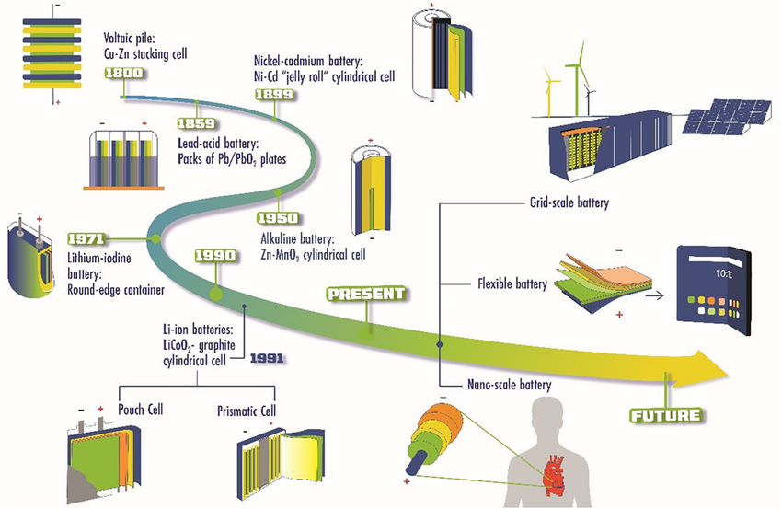
Thank you! Questions?

